Slide 1
End-to-End Semi-Supervised Object Detection with Soft Teacher
Mengde Xu, Zheng Zhang, Han Hu
Jianfeng Wang, Lijuan Wang, Fangyun Wei
Xiang Bai, Zicheng Liu
Huazhong University of Science and Technology
Microsoft
발표자 : 김병현
이미지처리팀 : 김선옥, 안종식, 이찬혁, 홍은기

Slide 2
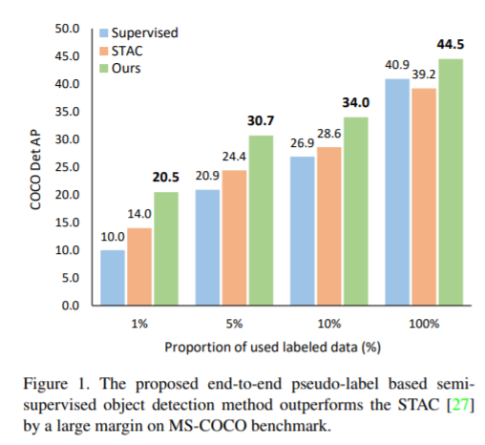

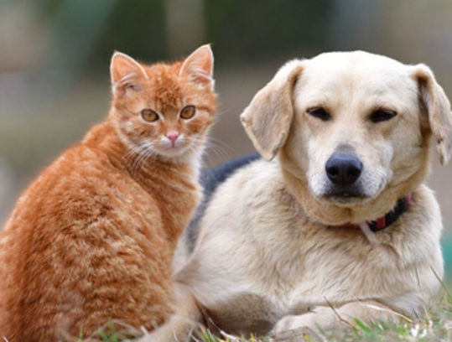
Brief Introduction of Soft Teacher
End-to-End Semi-Supervised Object Detection
Training Method for Semi-Supervised Object Detection Model
Currently ranked 1st place in COCO test-dev and COCO minival
(Papers with code)
Dog
Cat
Labeled
Unlabeled
Example of Semi-supervised learning

Slide 3
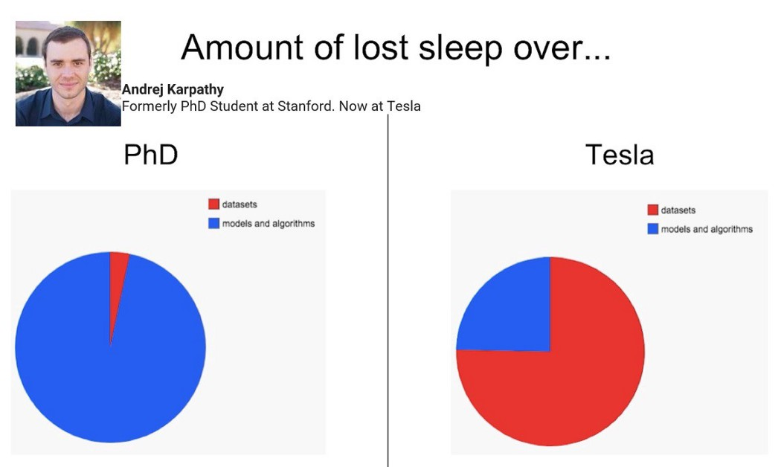
Expensive Labeling Cost in Deep Learning
Data Labeling can be a bottleneck ….
Datasets
Datasets
Model
Model
https://www.youtube.com/watch?v=y57wwucbXR8&t=512s&ab_channel=Databricks

Slide 4
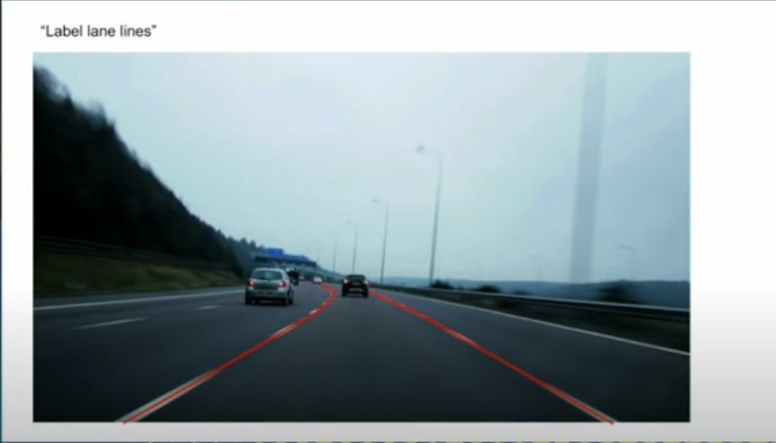
Expensive Labeling Cost in Deep Learning
Data Labeling can be a bottleneck ….
“Label lane lines”

Slide 5
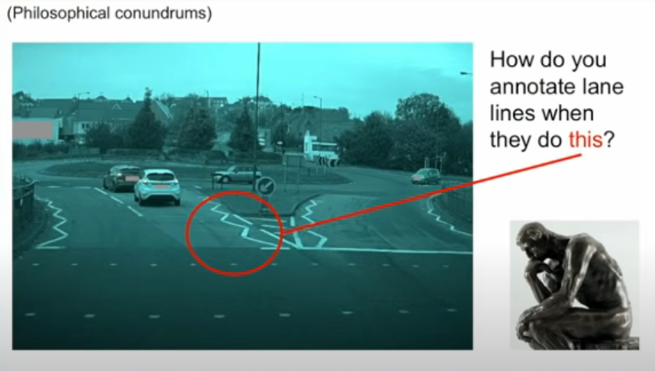
Expensive Labeling Cost in Deep Learning
Data Labeling can be a bottleneck ….
“Label lane lines…..??”

Slide 6
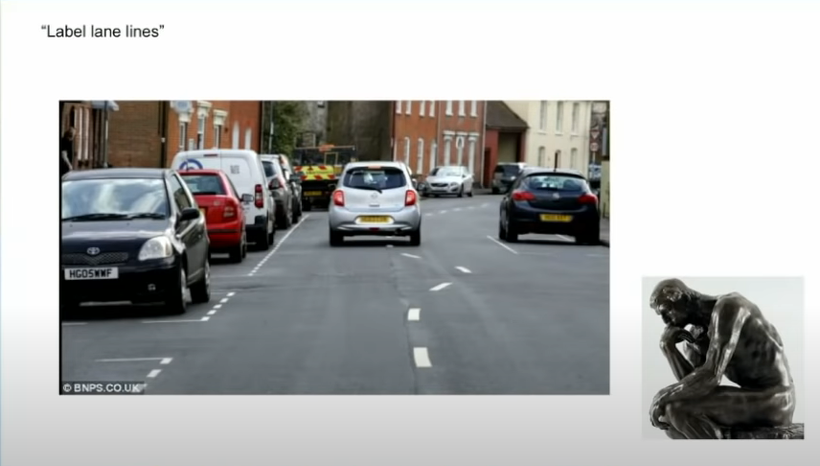
Expensive Labeling Cost in Deep Learning
Data Labeling can be a bottleneck ….
“Label lane lines…..??”

Slide 7
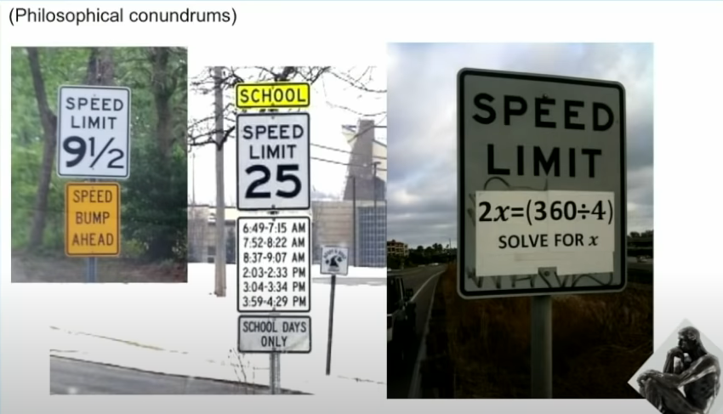
Expensive Labeling Cost in Deep Learning
Data Labeling can be a bottleneck ….
“Label speed limit sign…..??”
9½..?
Math?????
What time…?

Slide 8

Efforts to Reduce Labeling Cost
Training Deep Learning Model with Weak or Semi Supervision
Supervision
Weakly-Supervision
Dog
Cat
Dog
Cat
Dog
Cat
Dog
Cat
Labeled
No bounding box
Today’s Topic
Semi-supervision
Weakly Semi-Supervision
Dog
Dog
Cat
Cat
Dog
Cat
Labeled
Unlabeled
Labeled
No bounding box
Different types of object detection settings

Slide 9
Efforts to Reduce Labeling Cost
Training Deep Learning Model with Weak or Semi Supervision
Supervision
Weakly-Supervision
Dog
Cat
Dog
Cat
Dog
Cat
Dog
Cat
Labeled
No bounding box
Semi-supervision
Weakly Semi-Supervision
Dog
Dog
Cat
Cat
Dog
Cat
Labeled
Unlabeled
Labeled
No bounding box
Different types of object detection settings

Slide 10
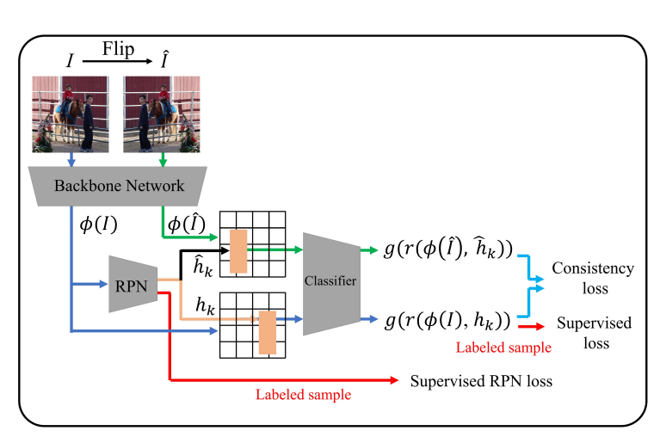
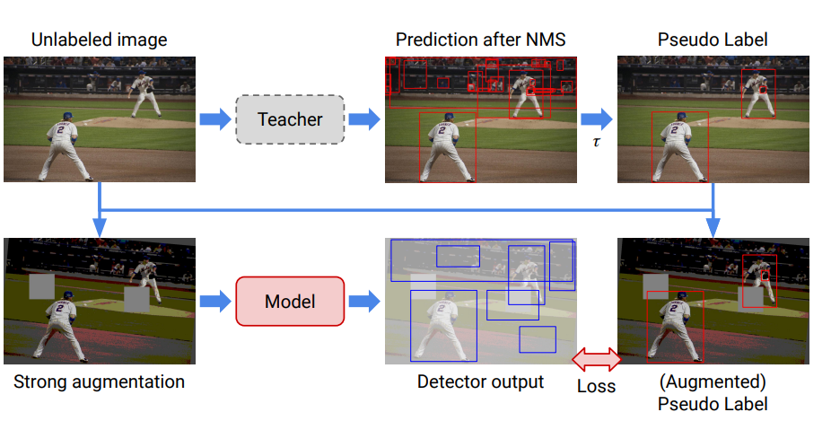
Semi-Supervised Approaches
Consistency methods
Consistency loss using a ‘consistency’ object detection result under weak augmentation.
Pseudo-label methods
Pseudo-label generation by teacher model
Jeong, J., Lee, S., Kim, J., & Kwak, N. (2019). Consistency-based semi-supervised learning for object detection. Advances in neural information processing systems, 32, 10759-10768.
Sohn, K., Zhang, Z., Li, C. L., Zhang, H., Lee, C. Y., & Pfister, T. (2020). A simple semi-supervised learning framework for object detection. arXiv preprint arXiv:2005.04757.

Slide 11
Semi-Supervised Approaches
Consistency methods
Consistency loss using a ‘consistency’ object detection result under weak augmentation.
Pseudo-label methods
Pseudo-label generation by teacher model
Jeong, J., Lee, S., Kim, J., & Kwak, N. (2019). Consistency-based semi-supervised learning for object detection. Advances in neural information processing systems, 32, 10759-10768.
Sohn, K., Zhang, Z., Li, C. L., Zhang, H., Lee, C. Y., & Pfister, T. (2020). A simple semi-supervised learning framework for object detection. arXiv preprint arXiv:2005.04757.

Slide 12
Semi-Supervised Approaches
Consistency methods
Consistency loss using a ‘consistency’ object detection result under weak augmentation.
Pseudo-label methods
Pseudo-label generation by teacher model
Final performance is limited to the pseudo label generator
Jeong, J., Lee, S., Kim, J., & Kwak, N. (2019). Consistency-based semi-supervised learning for object detection. Advances in neural information processing systems, 32, 10759-10768.
Sohn, K., Zhang, Z., Li, C. L., Zhang, H., Lee, C. Y., & Pfister, T. (2020). A simple semi-supervised learning framework for object detection. arXiv preprint arXiv:2005.04757.

Slide 13
Contribution of Soft Teacher
End-to-End Pseudo-Labeling Framework
Teacher gets better and better as the training goes on
Soft Teacher
Evaluate reliability of background box class during training
Box Jittering
Evaluate reliability of box regression during training
SOTA
Soft Teacher + Swin-L achieved mAP 61.3 in COCO test-dev set (Papers with code)

Slide 14
Q & A
Q & A

Slide 15
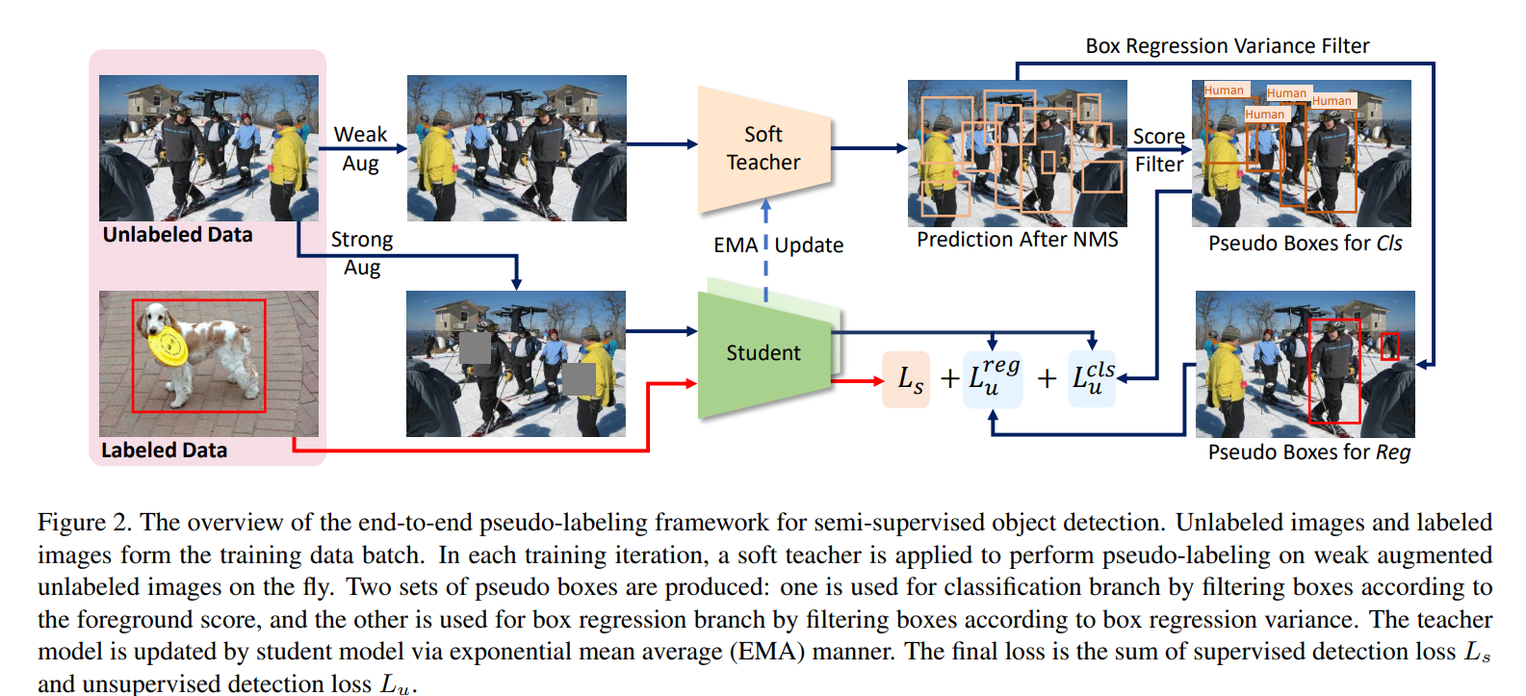
Overall Framework of Soft Teacher
End-to-End Pseudo-labeling Framework

Slide 16
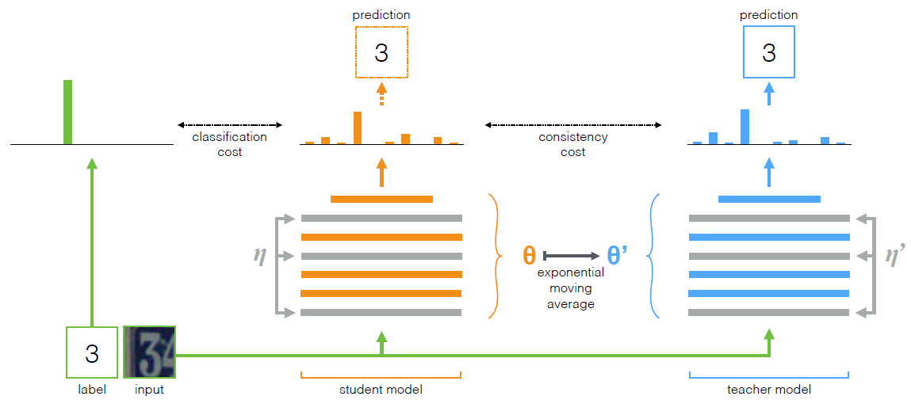
Exponential Moving Average
Tarvainen et al., 2018, Mean teachers are better role models: Weight-averaged consistency targets improve semi-supervised deep learning results

Slide 17
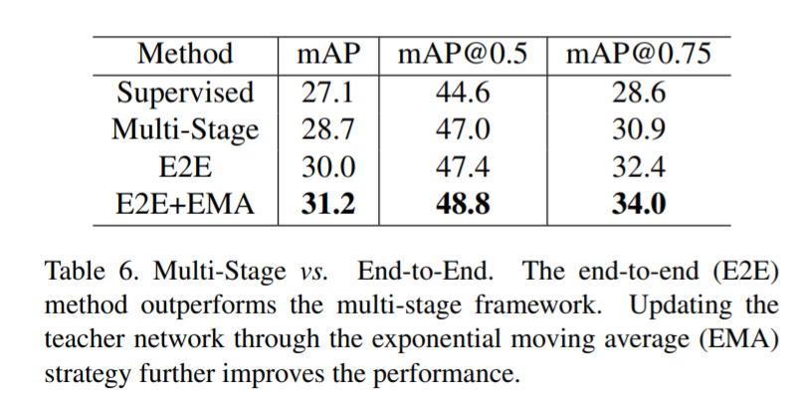
Exponential Moving Average
Training Result on 10% labeled images from train2017 set.

Slide 18
Q & A
Q & A

Slide 19
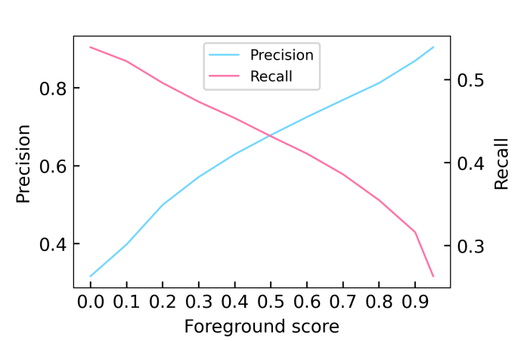
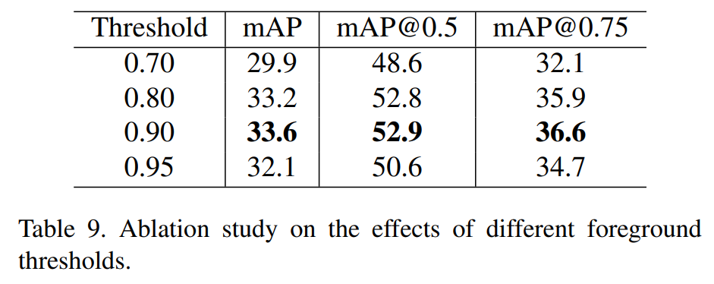
Soft Teacher
Motivation for Soft Teacher
Using a higher threshold on foreground can achieve better results than using a lower threshold.
This filters out most of the student-generated box candidates with low-confidence.
Some foreground box candidates will be mistakenly assigned as negatives if threshold is too high.

Slide 20
Soft Teacher
Motivation for Soft Teacher
Using a higher threshold on foreground can achieve better results than using a lower threshold.
This filters out most of the student-generated box candidates with low-confidence.
Some foreground box candidates will be mistakenly assigned as negatives if threshold is too high.
0.9

Slide 21
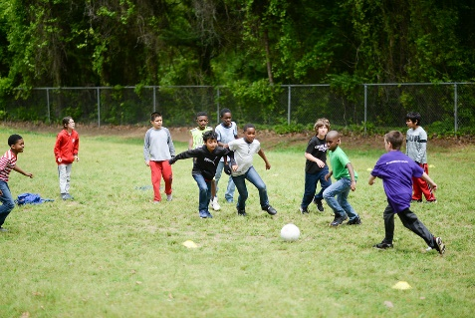

Soft Teacher
Motivation for Soft Teacher
High foreground threshold may hinder training and harm the performance
Teacher model generates pseudo-labels
Soft Teacher
Student

Slide 22
Soft Teacher
Motivation for Soft Teacher
High foreground threshold may hinder training and harm the performance
Student makes predictions
Soft Teacher
Student

Slide 23
Soft Teacher
Motivation for Soft Teacher
High foreground threshold may hinder training and harm the performance
Student makes predictions
Determined as foreground (IoU > 0.9)
Determined as background (IoU < 0.9)
Soft Teacher
Student

Slide 24
Soft Teacher
Soft Teacher Assess Background Reliability
Soft Teacher re-calculates student-generated boxes’ background confidence.
Soft Teacher
Background 0.3
Student
Background 0.1

Slide 25
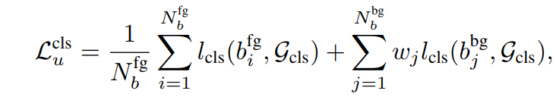
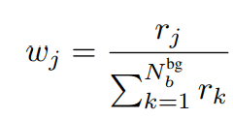
Soft Teacher
Soft Teacher Assess Background Reliability
Loss for bounding box classification
Foreground
background
Soft Teacher
Student
Background 0.1

Slide 26
Soft Teacher
Soft Teacher Assess Background Reliability
Loss for bounding box classification
Foreground
Background
Soft Teacher
Student
Background 0.1

Slide 27
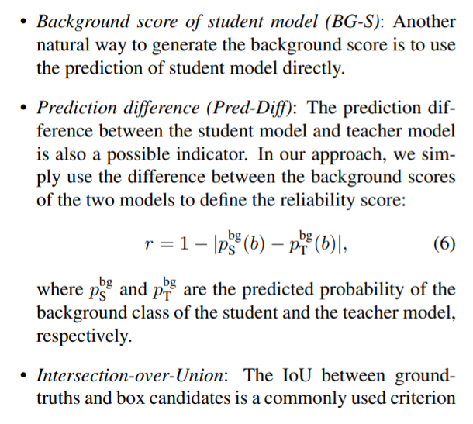
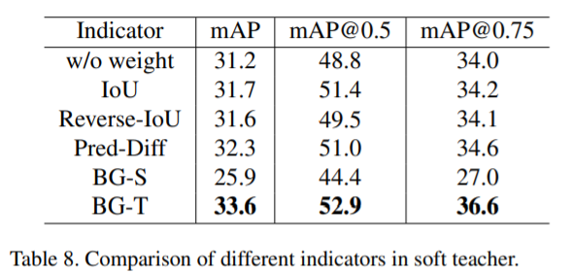
Soft Teacher
Ablation Study

Slide 28
Q & A
Q & A

Slide 29
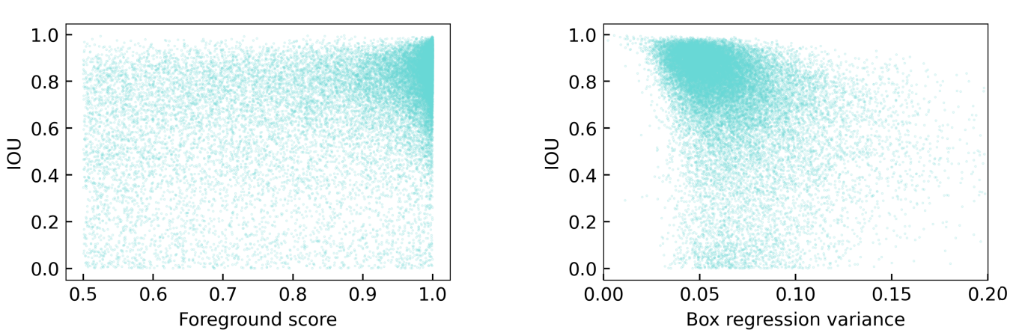
Box Jittering
Motivation for Box Jittering
The localization accuracy (IOU) and the foreground score of the box candidates do not show a strong positive correlation.
This indicates that the selection of the teacher-generated pseudo boxes according to the foreground score is not suitable for box regression, and a better criterion is needed.

Slide 30
Box Jittering
Motivation for Box Jittering
The localization accuracy (IOU) and the foreground score of the box candidates do not show a strong positive correlation.
This indicates that the selection of the teacher-generated pseudo boxes according to the foreground score is not suitable for box regression, and a better criterion is needed.
positive correlation
negative correlation

Slide 31
Box Jittering
Box Jittering Estimates Localization Reliability
Teacher model generates a pseudo-label. (Good regression result)
Soft Teacher
Student

Slide 32
Box Jittering
Box Jittering Estimates Localization Reliability
Jittered boxes are made from original prediction.
Soft Teacher
Student

Slide 33

Box Jittering
Box Jittering Estimates Localization Reliability
Jittered boxes from a well-regressed box have low variance of their coordinate
$$σ$$
Soft Teacher
Student

Slide 34
Box Jittering
Box Jittering Estimates Localization Reliability
Teacher model generates a pseudo-label. (Bas regression result)
Soft Teacher
Student

Slide 35
Box Jittering
Box Jittering Estimates Localization Reliability
Jittered boxes are made from original prediction.
Soft Teacher
Student

Slide 36
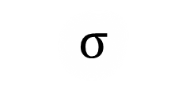
Box Jittering
Box Jittering Estimates Localization Reliability
Jittered boxes from a poor regression have high variance of their coordinate
$$σ$$
Soft Teacher
Student

Slide 37
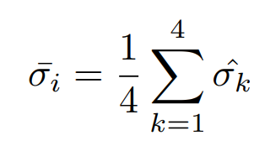
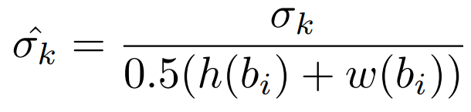
Box Jittering
Box Jittering Estimates Localization Reliability
Average by coordinates
Normalization by width and height
Boxes with low variance are used for pseudo-labels.
$$σ$$
Soft Teacher
Student

Slide 38
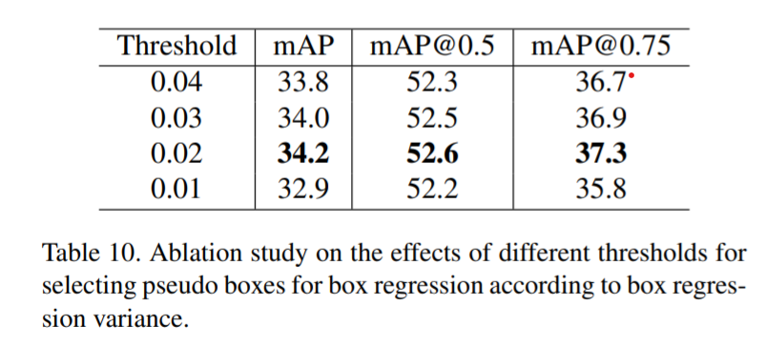
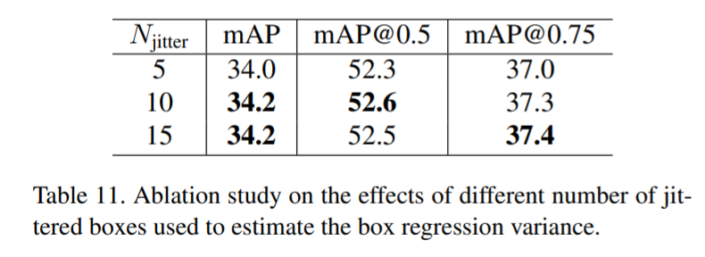
Box Jittering
Ablation studies

Slide 39
Q & A
Q & A

Slide 40
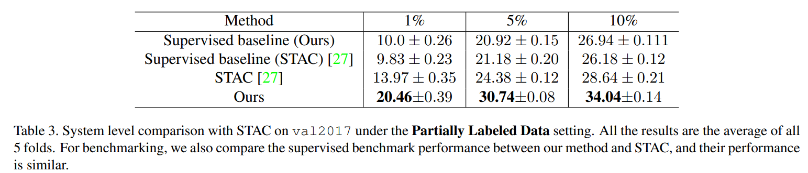
Experiments
State-of-the-art
in both Supervised and Semi-Supervisied Object Detection

Slide 41
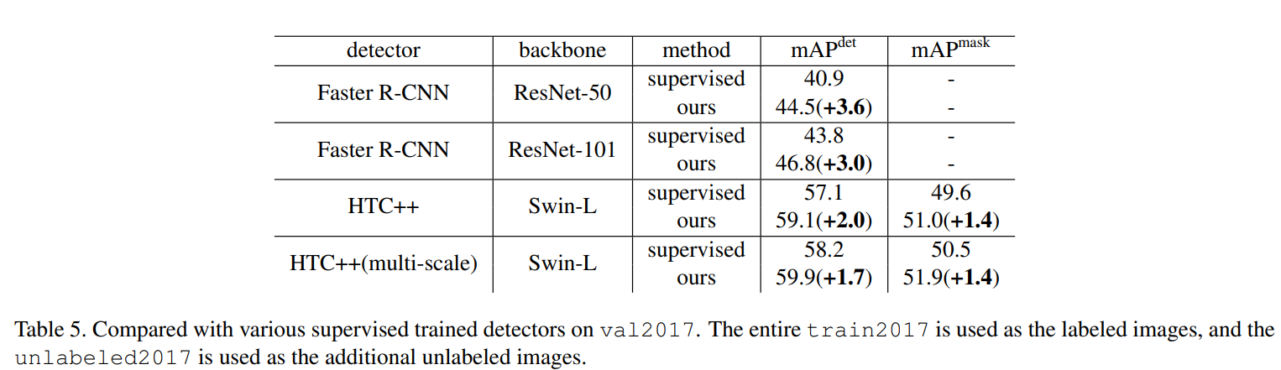
Experiments
State-of-the-art
in both Supervised and Semi-Supervisied Object Detection

Slide 42
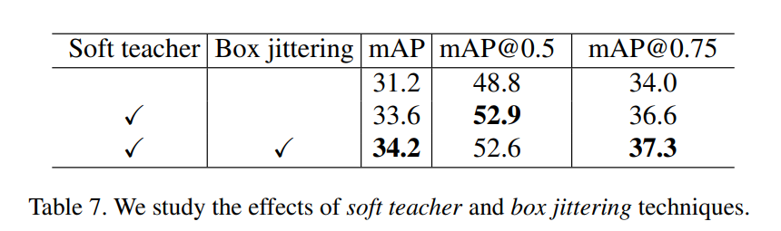
Experiments
Ablation Studies
Soft Teacher and Box Jittering

Slide 43
팀원간 Discussion
Pseudo-labeling 실험 셋업이 조금 아쉬움
Pseudo-labeling benchmark 평가 자체가 여러가지 Label 대 Unlabeled 비율(30%, 50% 80%) 등 다양하게 이루어졌으면 실무에 적용하는 입장에서 좋은 참고자료가 되었을 듯
앞으로도 Pseudo-Label의 신뢰도(Reliability)를 평가하는 방법론들을 중심으로 Semi-supervision에 대한 해결방법이 발전하지 않을까?

Slide 44
Q & A
Q & A

